Slide 1
Project Management Tool
19z219 – Indra Shekar G
19z241 – Sanjai M
19z245 – Soumen Saha
19z261 – Vivekanandhan S
19z263 – Manoj S
20z431 – Harish N R

Slide 2
TABLE OF CONTENTS
01
04
Introduction
Features
02
05
Abstract
Timeline
03
06
Literature Survey
References

Slide 3
INTRODUCTION
Software for project planning, scheduling, resource allocation, and change management is known as project management software. It enables cost control, quality management, and document management for project managers (PMs), stakeholders, and users. It may also be used as an administration system. Software for project management is also utilised for stakeholder participation and communication. Project management tools are a collection of software created to assist project teams in project planning, project tracking, and project management in order to meet project goals within a certain time frame. Additionally, it fosters productive teamwork and speeds up tasks so they may be completed within the given deadlines.

Slide 4
ABSTRACT
Project management tools are a collection of software created to assist project teams in project planning, project tracking, and project management in order to meet project goals within a certain time frame. Additionally, it fosters productive teamwork and speeds up tasks so they may be completed within the given deadlines. We made the decision to create a web application using FERN stack to implement the functions listed above. To define a project schedule, a project manager (PM) may use the software to map project tasks and visually describe task interactions.

Slide 5
LITERATURE SURVEY
Paper Title | Citation | Description
Website Design and User Engagement | ElevateU, Los Angeles, CA, USA ²University of California Institute for Prediction Technology, Department of Family Medicine, University of California, Los Angeles, Los Angeles, CA, USA ³UCLA Center for Digital Behavior, Department of Family Medicine, University of California, Los Angeles, Los Angeles, CA, USA | The seven website design elements most often discussed in relation to user engagement in the reviewed studies were navigation (62.86%), graphical representation (60%), organization (42.86%), content utility (37.14%), purpose (31.43%), simplicity (31.43%), and readability (31.43%). These seven elements exceeded our threshold level of 30% representation in the literature and were included into a short list of website design elements to operationalize effective website design. For further analysis, we reviewed how studies defined and evaluated these seven elements.

Slide 6
LITERATURE SURVEY
Paper Title | Citation | Description
Technologies for Web Application Development | BARRY DOYLE University of California, Irvine and CRISTINA VIDEIRA LOPES University of California, Irvine Apache Software Foundation 1996–2003. Apache HTTP Server Version 1.3: Apache API Notes. Apache Software Foundation. Apache Software Foundation 1999-2004. Apache HTTP Server Project. Apache Software Foundation. | The earliest technical elements that allowed for interactive and dynamic content were HTML forms, the HTTP POST request method, and the Common Gateway Interface (CGI). HTML forms are used to collect user input data that is submitted to a forms processor on a Web server in a GET or POST message. By 1993, the availability of CGI completed the forms processing path by providing a means by which Web servers could process and respond to submitted data. CGI is functional but not scalable; as its limitations became clear other solutions were developed that were more efficient but more complicated.

Slide 7


LITERATURE SURVEY
Jira is a proprietary issue tracking product developed by Atlassian that allows bug tracking and agile project management. Jira is used for issue tracking and project management by over 180,000 customers in 190 countries. Some of the organizations that have used Jira at some point in time for bug-tracking and project management include Fedora Commons, Hibernate, and the Apache Software Foundation, which uses both Jira and Bugzilla.
OpenProj was an open-source project management software application. It has not been updated since 2008 and is not supported. OpenProj has not been supported for over 10 years. Serena software previously issued a warning and asked users to use ProjectLibre. As of version 1.4, bugs in the software generally only manifest for users who are attempting more advanced features.

Slide 8

MAIN FUNCTIONALITIES
Project Planning
Project planning is part of project management, which relates to the use of schedules such as Gantt charts to plan and subsequently report progress within the project environment. Project planning can be done manually or by the use of project management software.
The project scope is defined and the appropriate methods for completing the project are determined. Following this step, the durations for the various tasks necessary to complete the work are listed and grouped into a work breakdown structure
Project planning is often used to organize different areas of a project, including project plans, work loads and the management of teams and individuals.

Slide 9
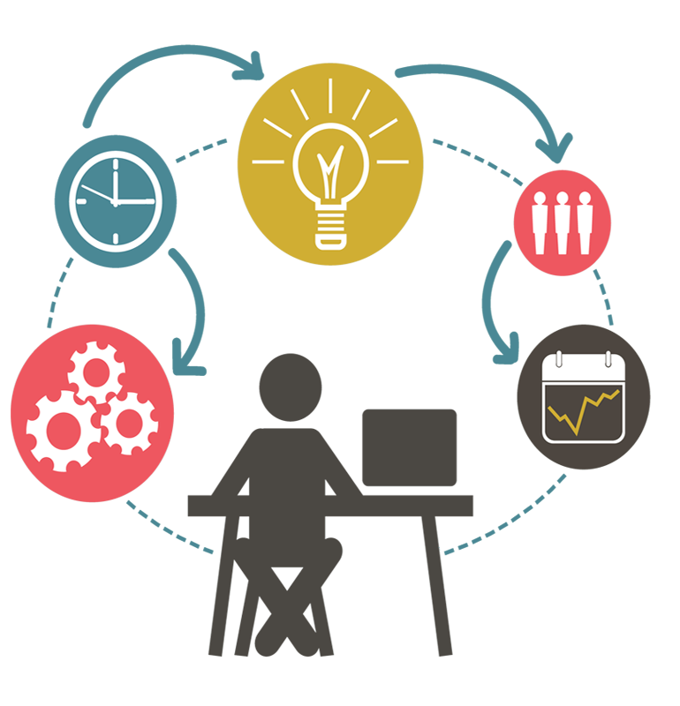
MAIN FUNCTIONALITIES, Cont
Task Management
Time Tracking
In project management, a task is an activity that needs to be accomplished within a defined period of time or by a deadline to work towards work-related goals. It is a small essential piece of a job that serves as a means to differentiate various components of a project.
We will include a separate page for assigning and addressing different tasks in a project
Team lead will have permission to assign task for individual team member and delete task respectively
Time tracking lets your team record the time they spend working on issues. you won’t lose any existing data if you disable or re-enable it.
We will implement time tracking by default.
We can have visual representation for tracking the team progress.

Slide 10
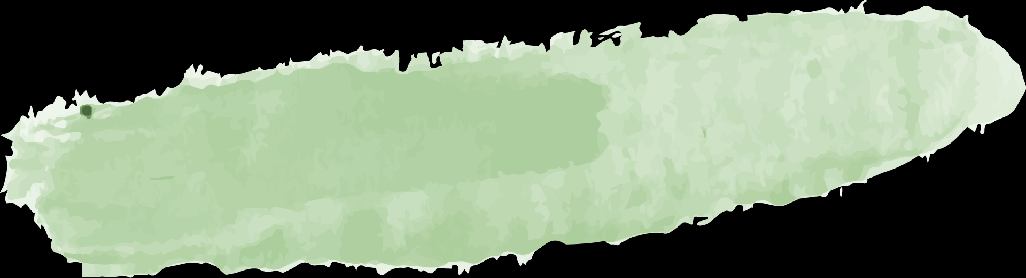



SYSTEM REQUIREMENTS
04
Back-End
Node JS, Firebase, Express
03
Front-End
ReactJs, TailwindCSS, JavaScript
02
Software
Any Browser which can browse through internet
01
Hardware
Any PC configuration which has access to internet

Slide 11
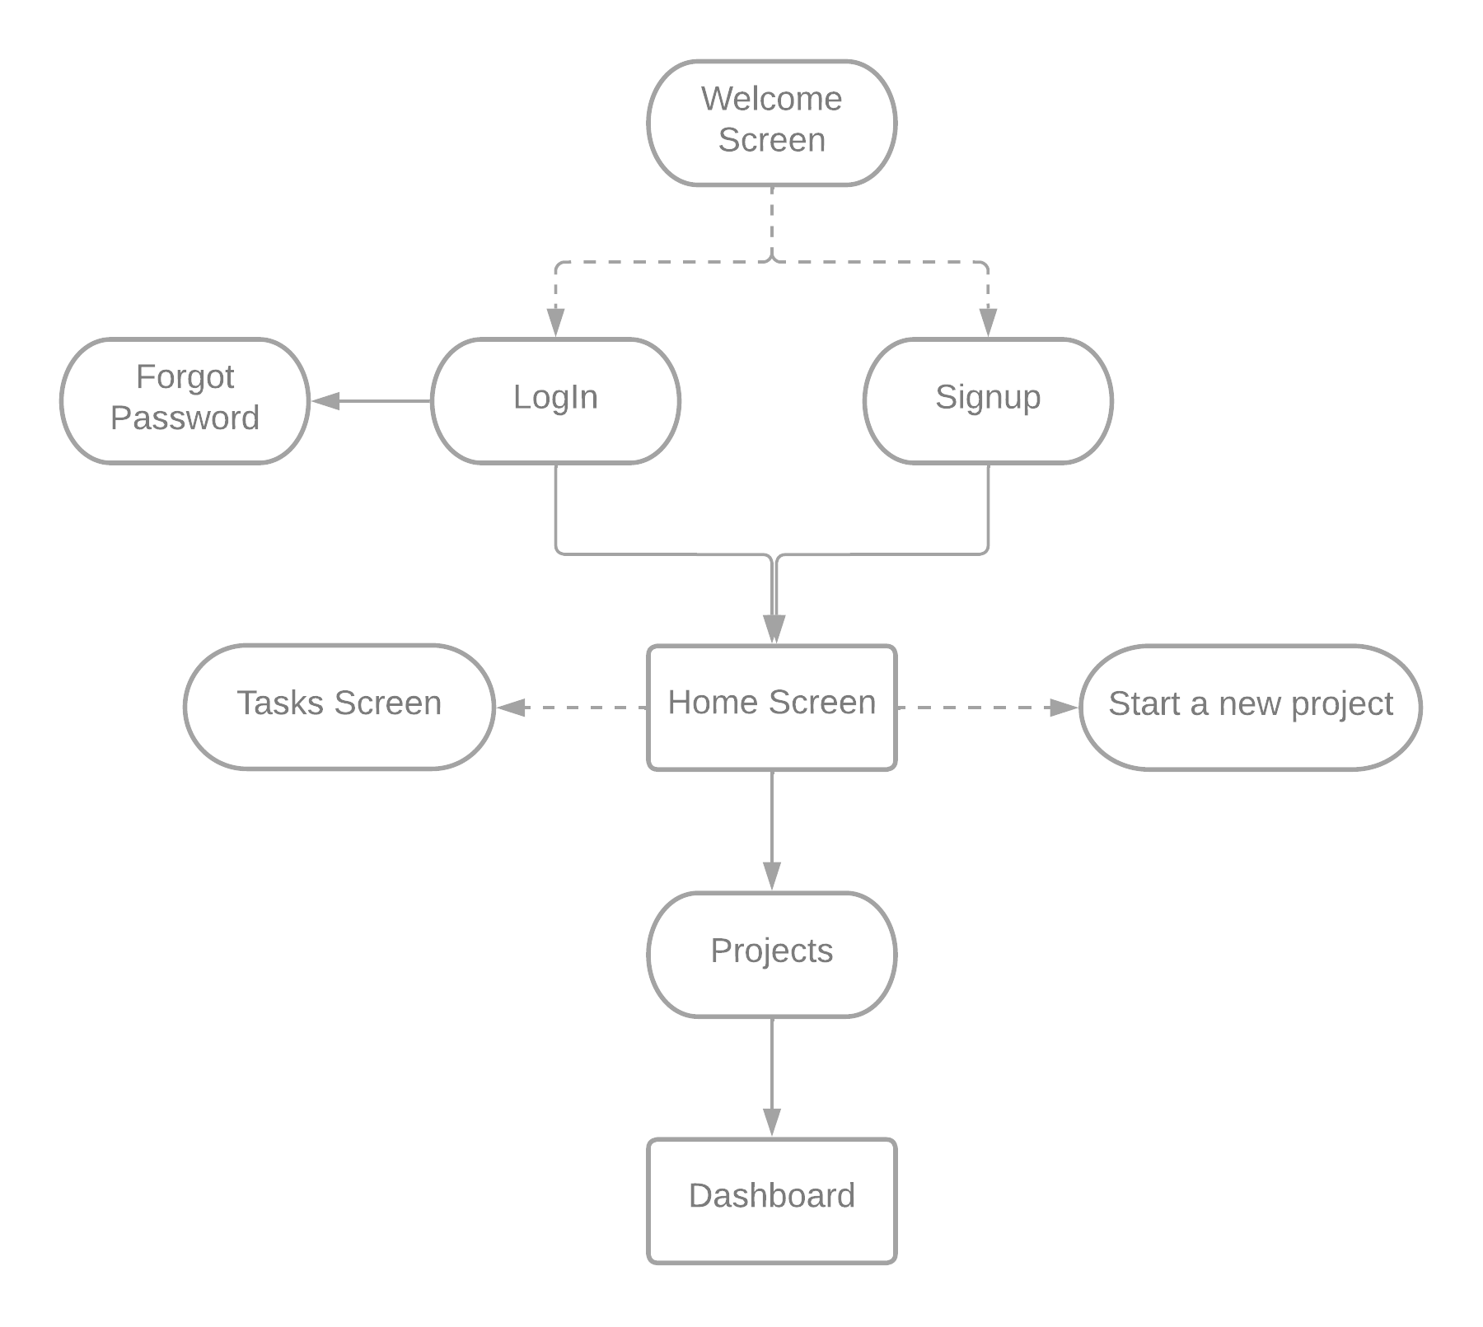
FLOW DIAGRAM

Slide 12
OUR TIMELINE
BACKEND
DESIGNING
START
FINAL
VERSION
FRONTEND
INTEGRATION
Building Api endpoints and creating features before
27-02-2023
UI/UX designing before
27-01-2023
Implementing Design using ReactJs before
27-01-2023
Integrating Frontend, backend, Database before 30-03-2023

Slide 13
REFERENCES
https://reactjs.org/docs/getting-started.html
https://firebase.google.com/docs
https://developer.mozilla.org/en-US/docs/Web/CSS
https://developer.mozilla.org/en-US/docs/Web/HTML
https://support.atlassian.com/jira-software-cloud/resources/

Slide 14
THANKS!
19z219 – Indra Shekar G
19z241 – Sanjai M
19z245 – Soumen Saha
19z261 – Vivekanandhan S
19z263 – Manoj S
20z431 – Harish N R

